Slide 1
Studying Abroad & Teaching Roles
Notes:
When students have arrived, Leaders should introduce themselves and give a brief recap of what InfPALS is.

Slide 2

Studying Abroad
WHAT?
Studying in a different country for a year.
WHEN?
In your 3rd year.
WHERE?
We will talk about that later …

Slide 3
Two Types of Exchanges!
Subject-specific
Only students from the school of Informatics are able to apply.
Moderately Competitive
University-wide
All students on any degree can apply to these.
Highly Competitive
Both have slightly different assessment processes, we will talk about that later…
Good news! You can apply to both :)

Slide 4
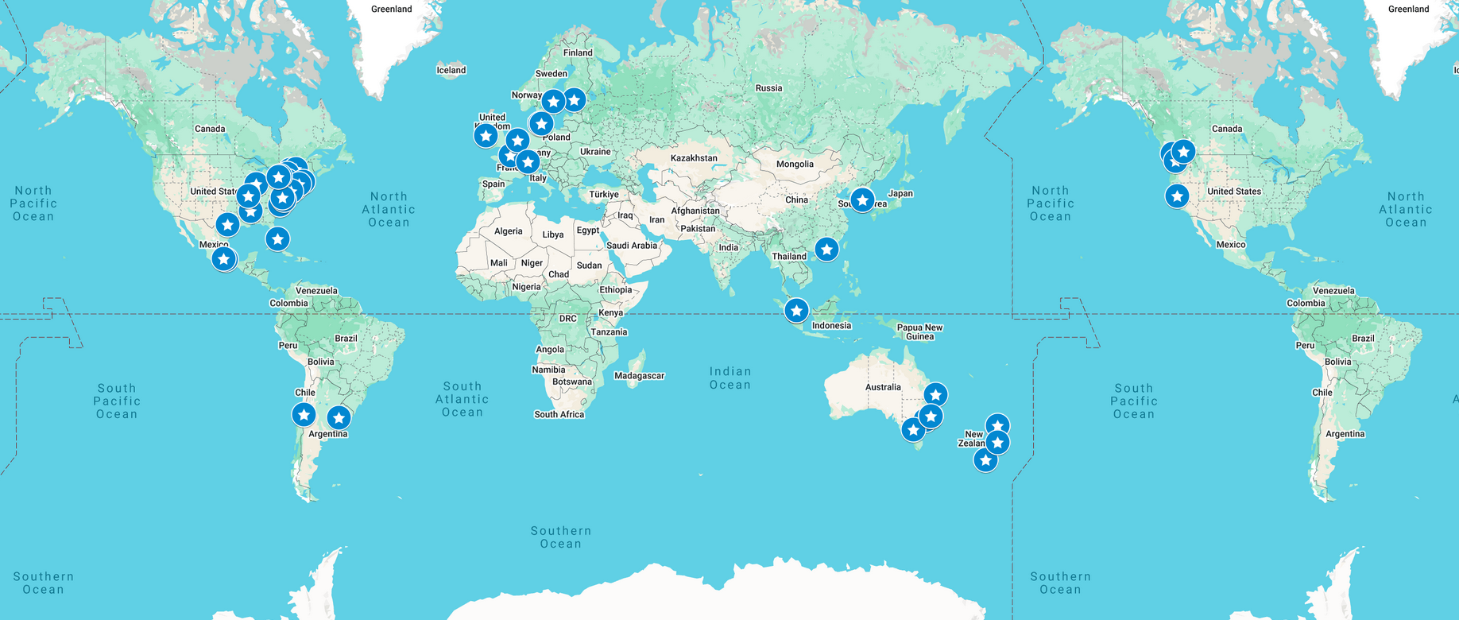
Where Can I go ? (University-wide)

Slide 5


Slide 6
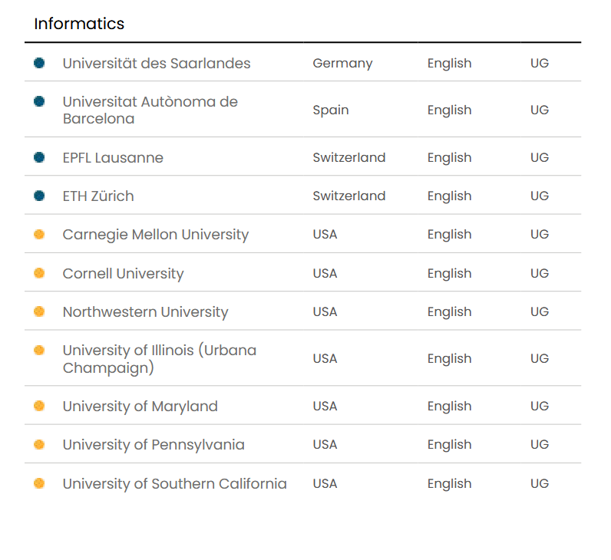
Where Can I go ? (Subject-specific)

Slide 7
https://global.ed.ac.uk/study-work-away/study-exchanges

Slide 8


Application process
You will be applying in semester 1 of your second year.
Applications typically open at the end of October and close in mid-November. (For 2025, applications open on the 29th of October and close on the 12th of November.
Your application is assessed in the following way:
50% 50%
First-year Grades Personal Statement

Slide 9
Difference between Subject-specific and University-wide
For subject-specific exchanges, your personal statement is marked by your exchange coordinator. Grades are calculated using the School of Informatics’ own weighting algorithm rather than a simple average.
For university-wide exchanges, your personal statement is marked by randomly selected students who are also applying for a university-wide exchange.

Slide 10
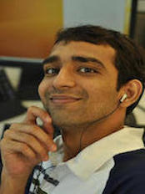
Who is my exchange coordinator this year?
(This year, it might be someone else next year)
Mr Yuvraj Patel
Email: yuvraj.patel@ed.ac.uk
Do not contact him if your query is purely administrative!
First, check the SWAY website (https://global.ed.ac.uk/study-work-away/study-exchanges/about-study-exchanges)
If you need to contact someone about an administrative query, email SWAY at: studyabroad@ed.ac.uk

Slide 11
Three main benefits of going abroad (in my opinion)
Your study abroad grades don’t count towards your final degree classification
You pay the same tuition fees as in Edinburgh
You get to experience new cultures and perspectives

Slide 12
Teaching roles

Slide 13
What can you be?
If you’ve done well academically, you can apply to become a lab demonstrator in your second year.
This opportunity is exclusive for Informatics Students. Instructions on how to apply are usually sent by email around June or July.
Apply only after completing your first-year.
Tip: Apply for classes you’ve taken and enjoyed!

Slide 14
Why should I be doing lab demonstrating?
It's a paid position
It looks great on your CV!
It is fun to help others and share what you’ve learned

Slide 15
Other ways to get involved
You can also apply to become an InfPALS leader!
Recruitment takes place in the second semester, so keep an eye on our Instagram page and posters around campus for updates.

Slide 16
That’s all! Hope you have a great Tuesday evening!

